Slide 1
Recycling Identification System for Public Waste Management
Shivam Singh, Mark Glinberg, Nityam Bhachawat

Slide 2
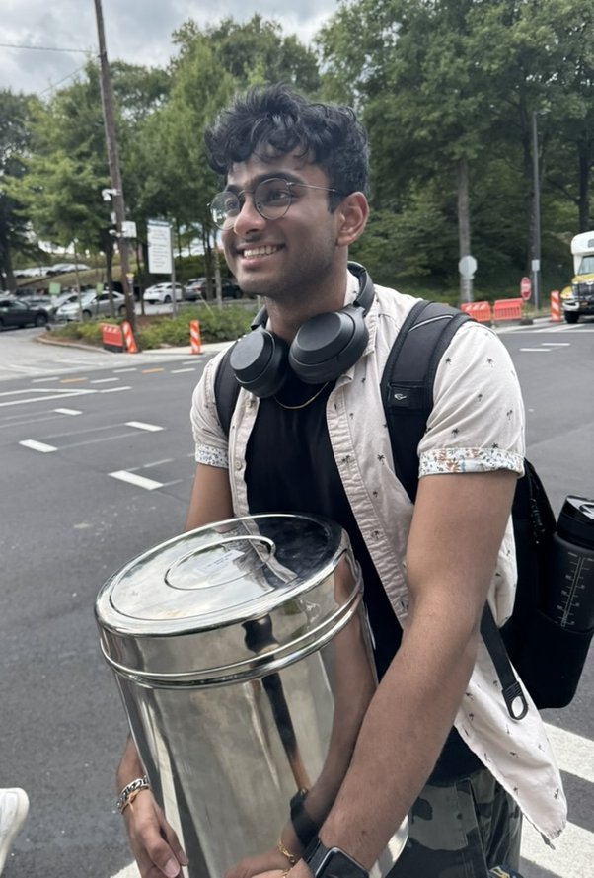
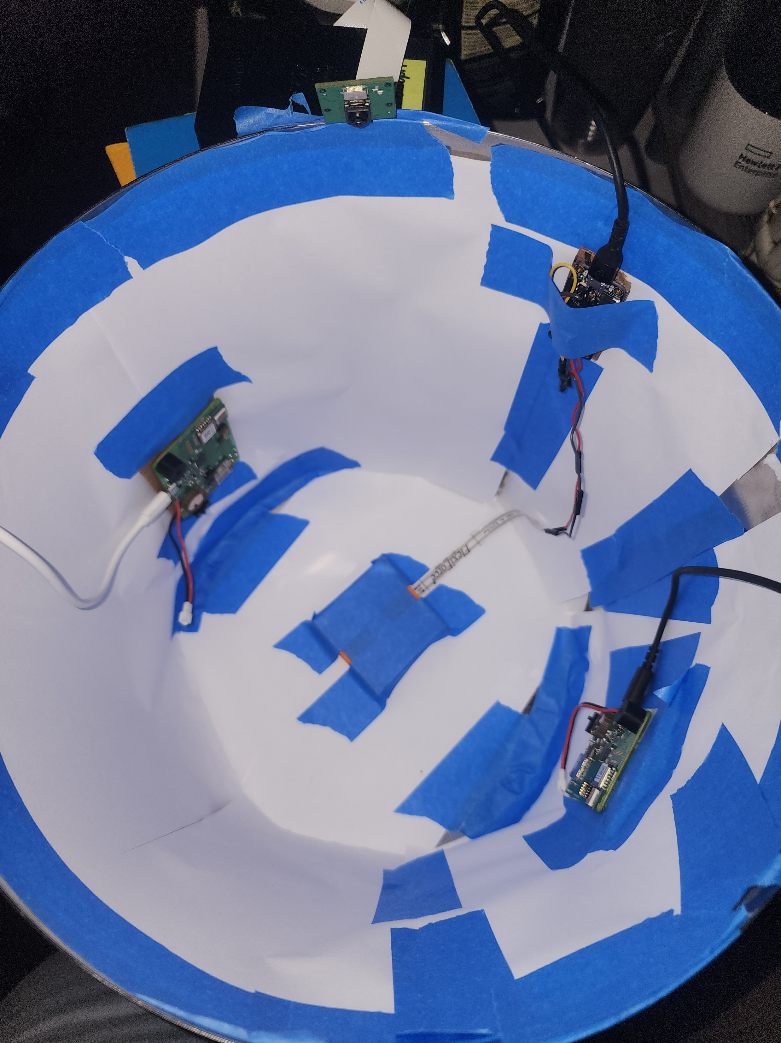
Setup
Metal Container
Paper inside to block reflections
Raspberry Pi
Camera
Load Sensor
2 UWB Sensors
Code and Files:
https://github.com/specialsyt/recycling-identification-system
Raspberry Pi
Camera
Load Sensor and ADC
Load Sensor Platform
UWBs

Slide 3
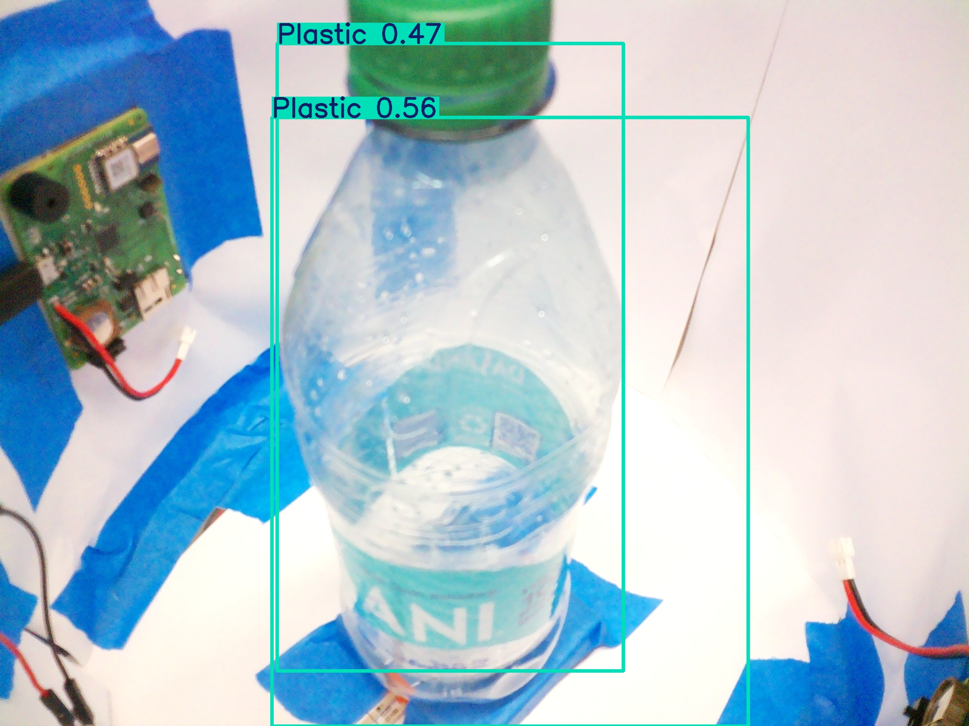
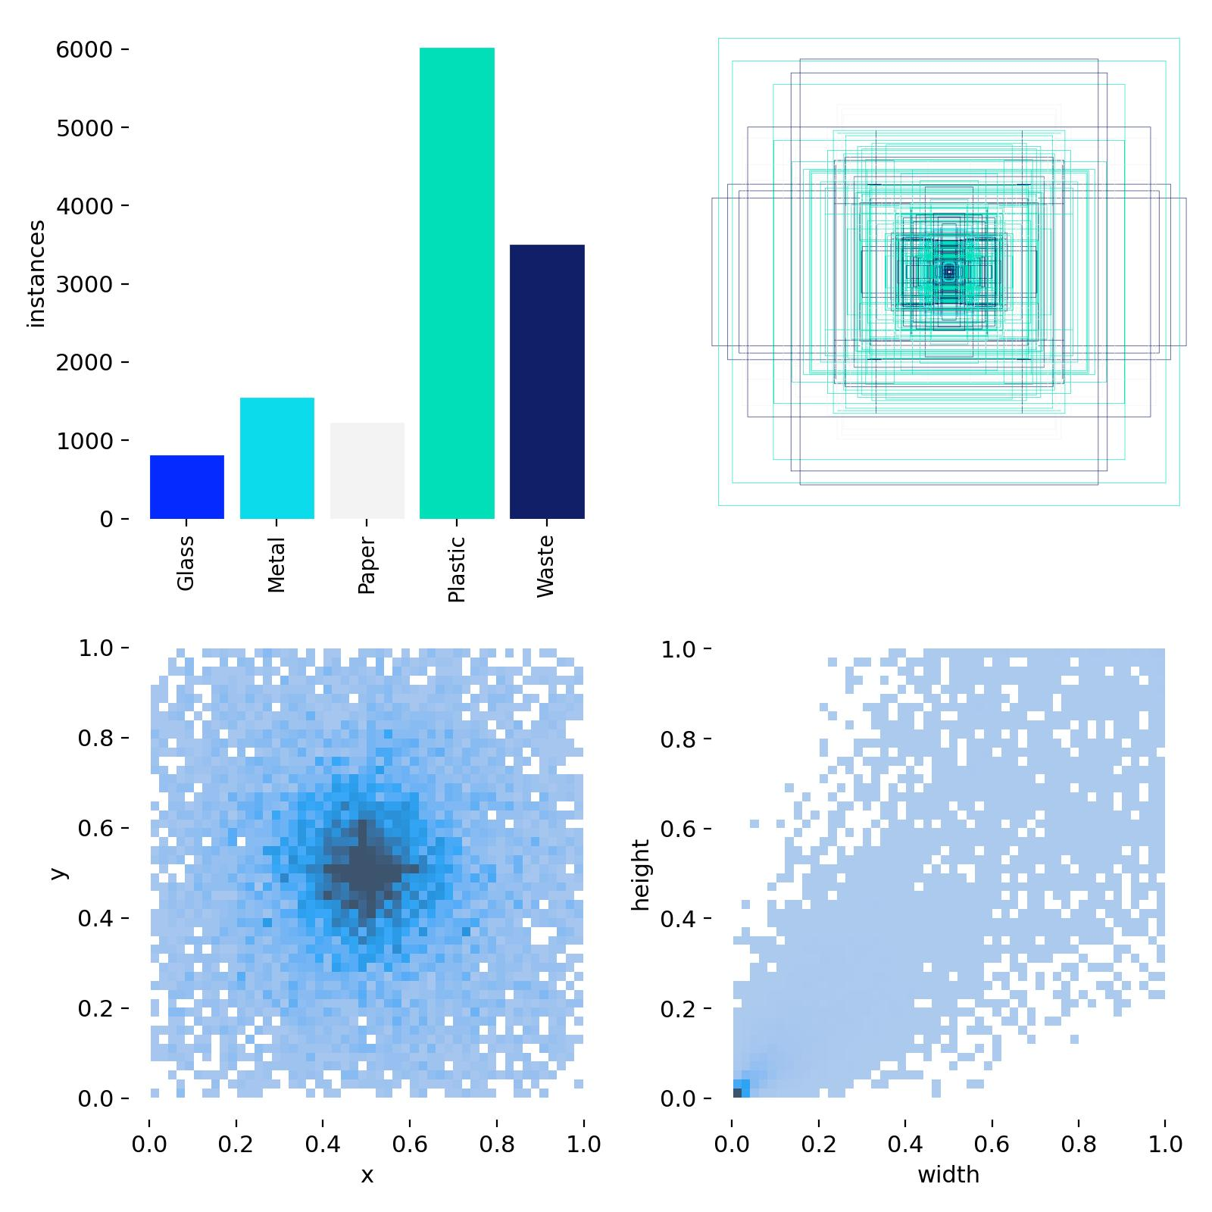
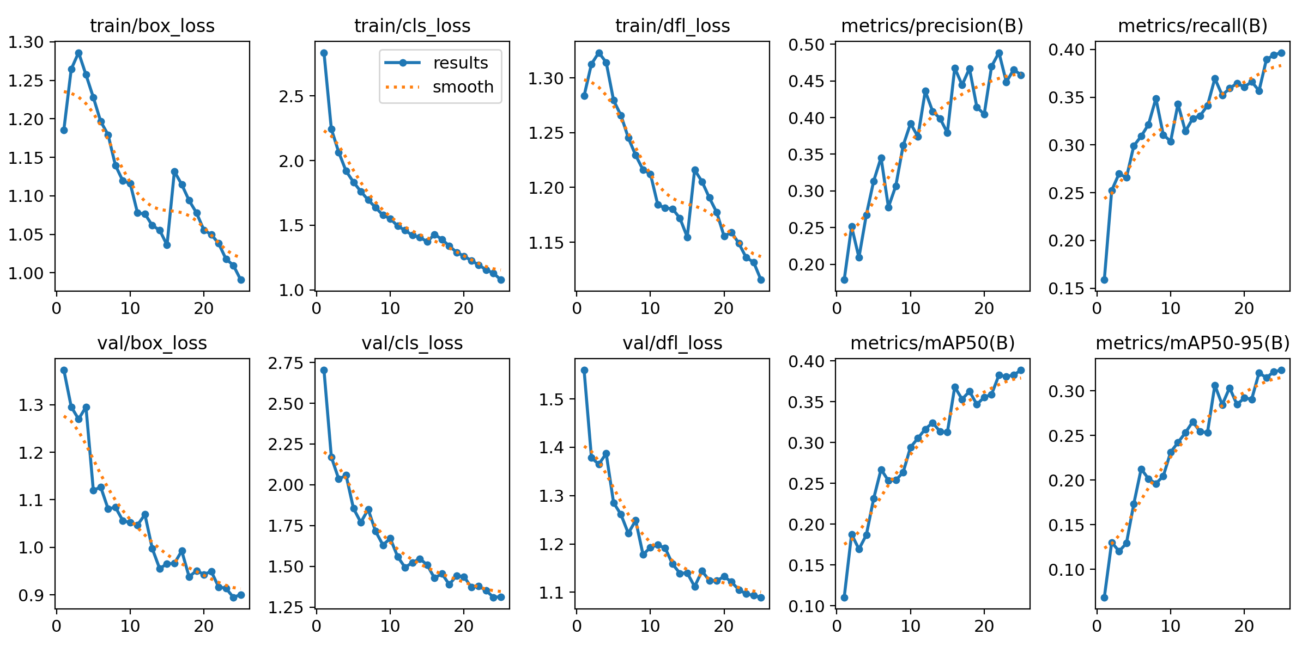
Camera
Raspberry Pi 1080p Camera
YOLO model
Fine-tuned on custom dataset
Required higher fidelity images with more depth
OpenAI as a backup
Used OpenAI API to aid with classification

Slide 4
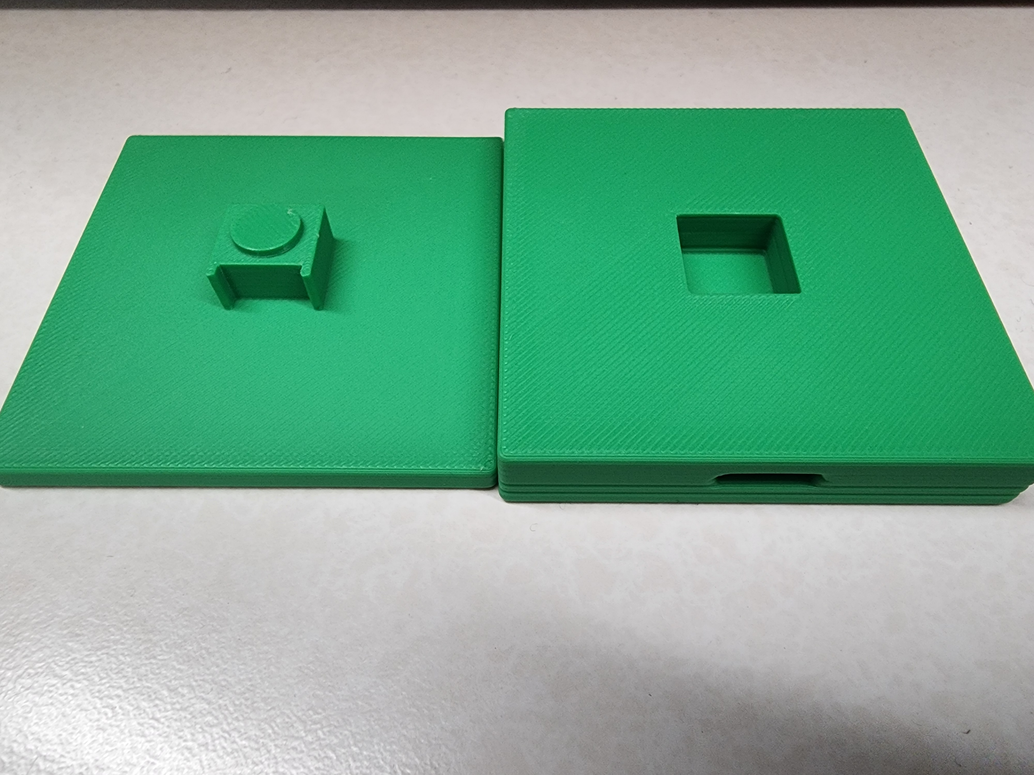
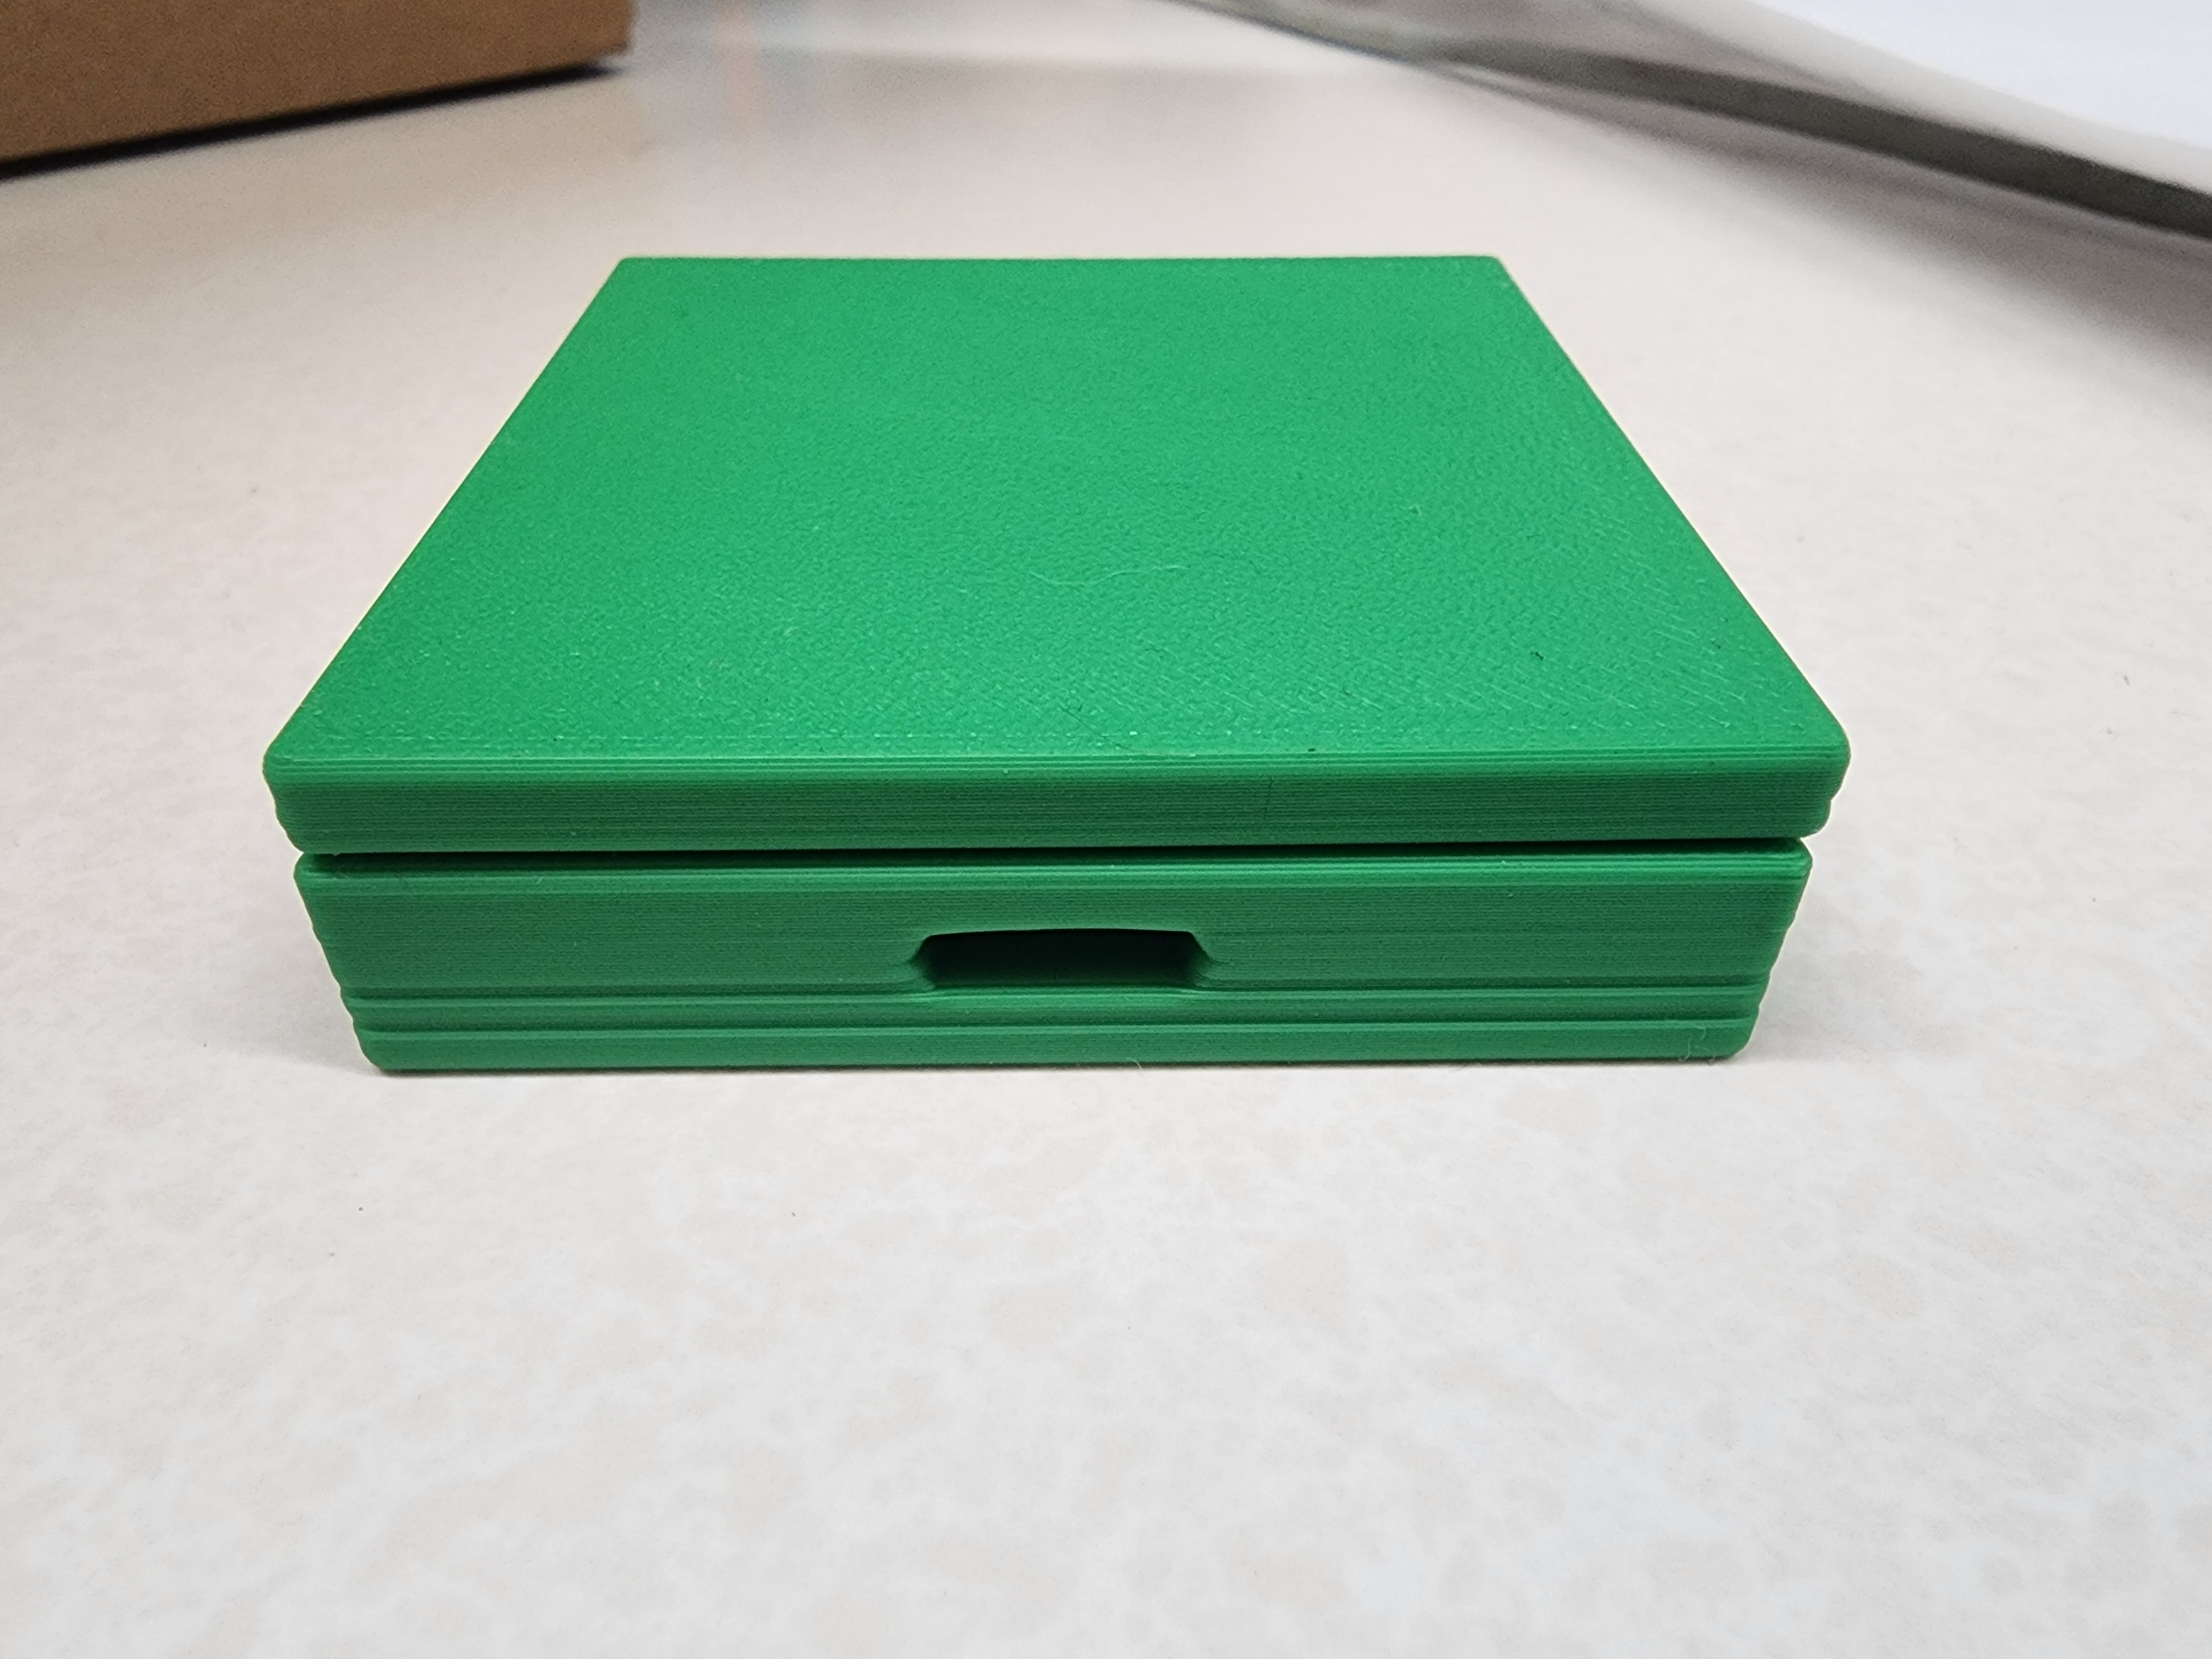
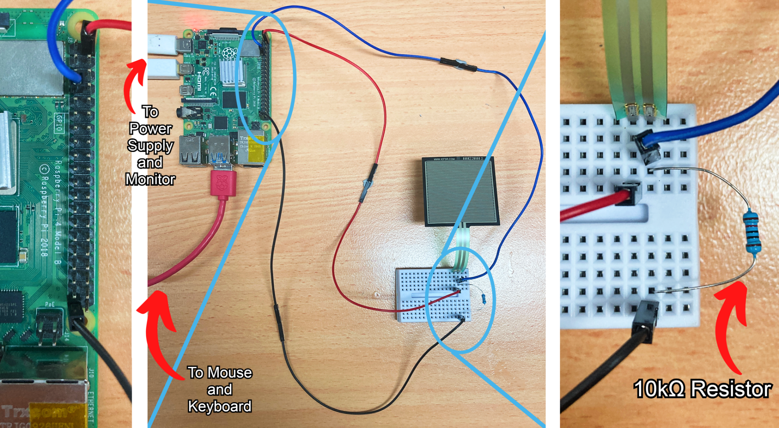
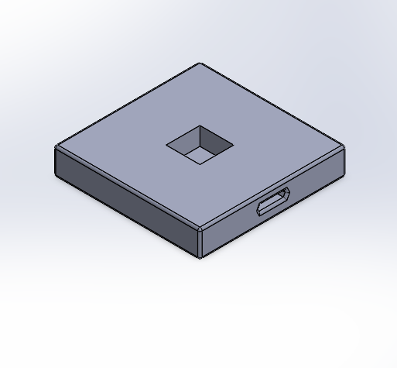
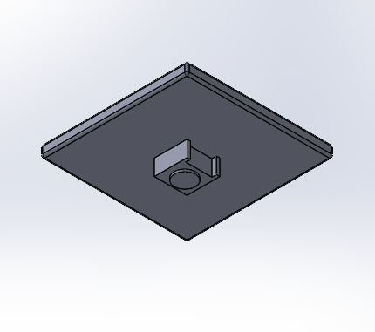
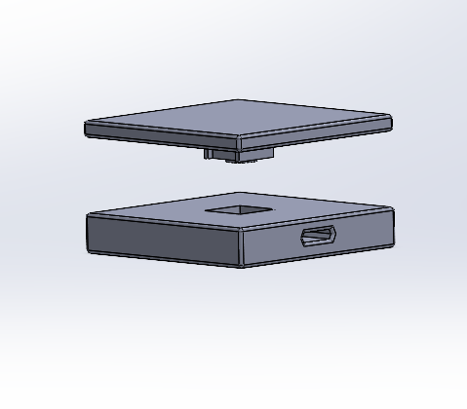
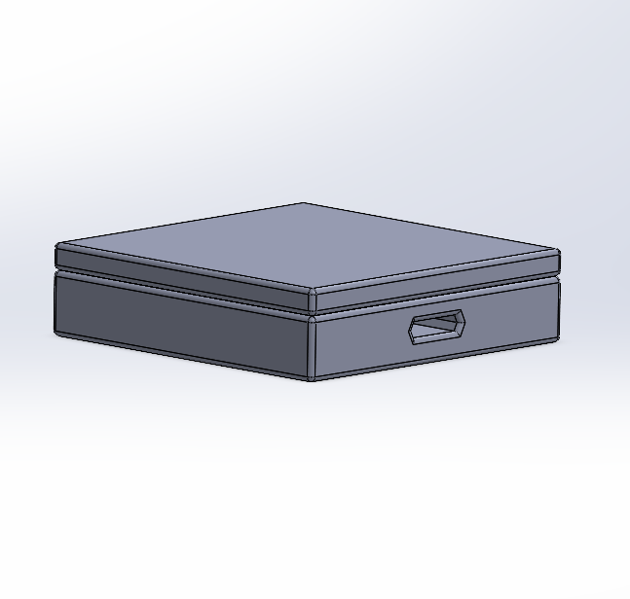
Load Sensor
FlexiForce A201 Sensor
Lowers resistance when compressed, increasing the measured voltage
Analog Pins read at 12 bits (values 0-4095), so can be scaled to voltage by v = 3.3x / 4095
3D Printed Case
Adafruit Feather M0 Express ADC
Ran into inconsistency issues due to soldering
Output ADC value and Voltage
Averaged 20 samples of ADC value over 1 second

Slide 5
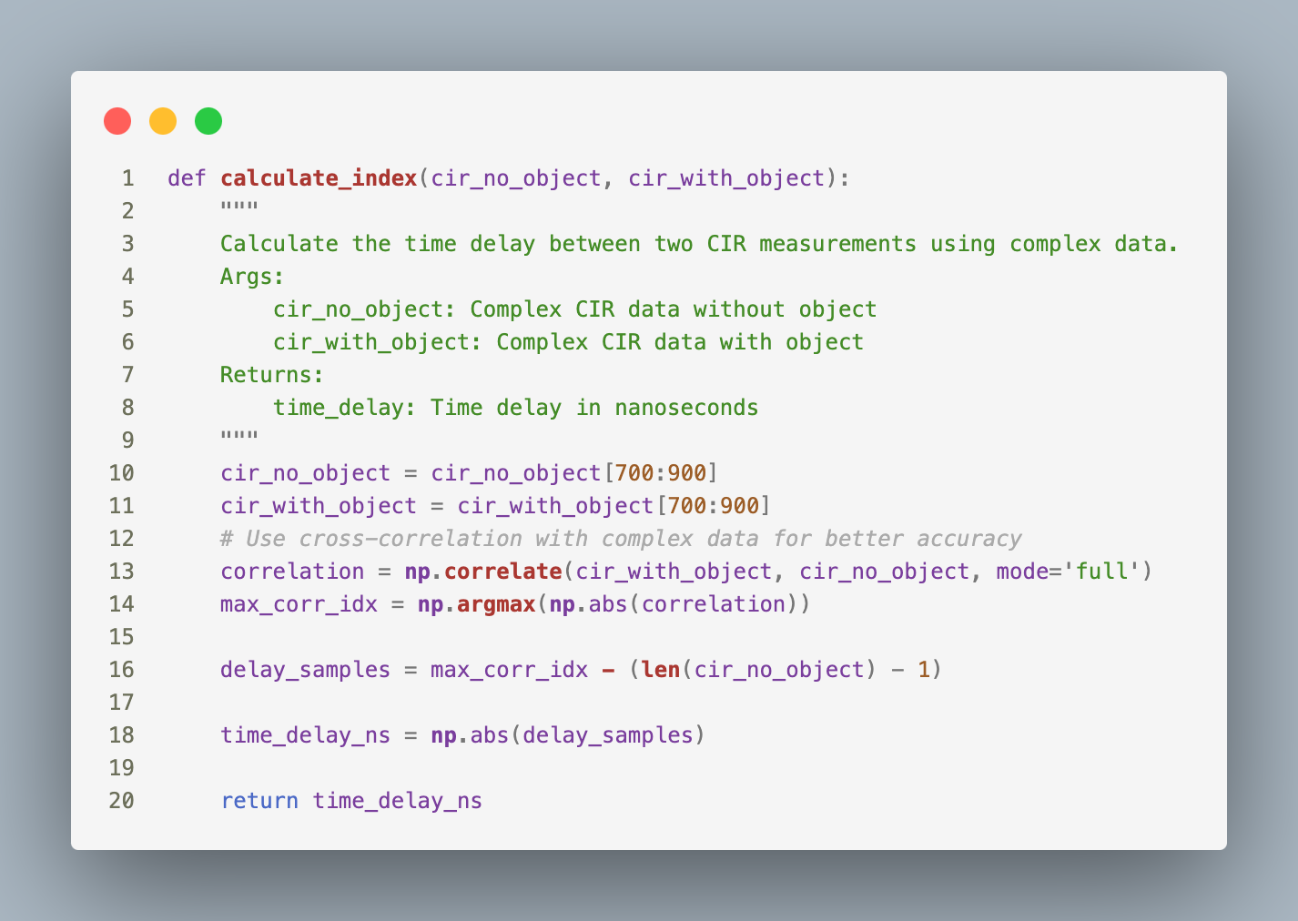



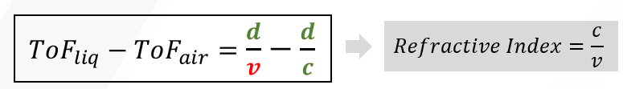
UWB
Modified TWR output to Channel Impulse Response (CIR)
Measured cross correlation in CIR
Gives insight into object composition
Refractive index can’t be calculated without knowing thickness
UWB setup was difficult (used outdated libraries)
UWB sensor serial communication ran into issues on the Raspberry Pi
We connected them to a laptop and sent data to the Pi via external API as backup
CIR peak differences were well within margin of error, results weren’t helpful for classification

Slide 6
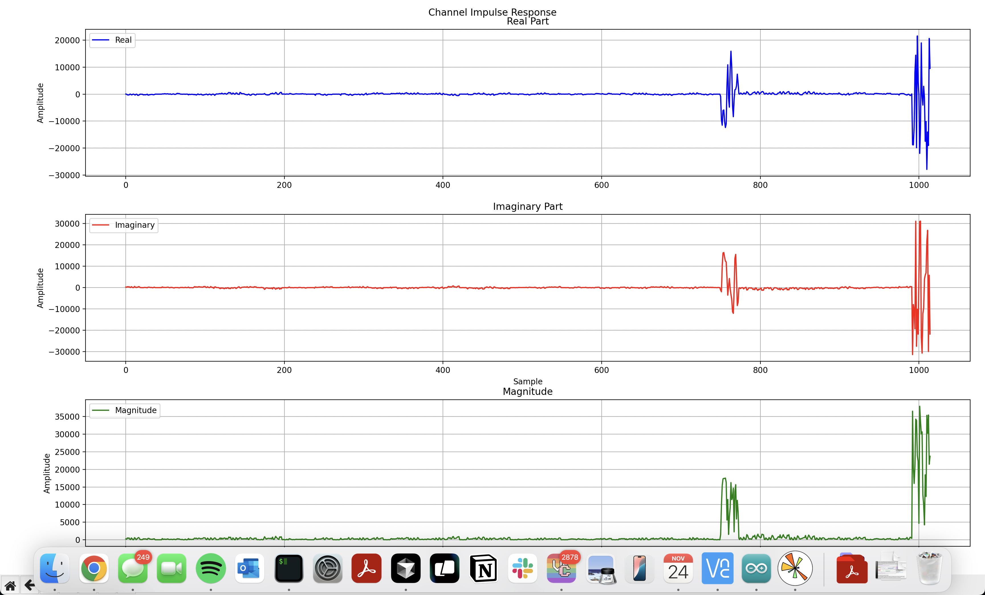
UWB

Slide 7
Methodology and Results
Start script
Get UWB CIR with nothing there
Get load sensor reading with no object
Place Object
Get UWB CIR with object
Get load sensor reading with object
Get image and classify (YOLO and OpenAI)
Use all the above data points to classify object
Nearest Neighbor with existing data points
Save data point for future classifications
Vision model identifies clear objects as plastic, but can distinguish the rest well
YOLO struggles with low fidelity, OpenAI greatly helps these predictions
Load sensor helps distinguish between glass and plastic
Plastic and metal are often too light to provide good data points
UWB in theory would distinguish between full plastic bottles and empty glass bottles
CIR peak differences are too small

Slide 8
References
https://core-electronics.com.au/guides/force-sensitive-pads-raspberry-pi/
https://www.tekscan.com/sites/default/files/resources/FLX-Datasheet-A201-RevI.pdf
https://www.adafruit.com/product/3403?gad_source=1&gclid=Cj0KCQiAuou6BhDhARIsAIfgrn6ctTSm-DQVjLh3pKMRvGc9iCZPzZIif_SJrcqGiEkxk4_SlcXT8VMaAk6DEALw_wcB
https://thetoolchain.com/mirror/dw1000/dw1000_user_manual_v2.05.pdf
https://universe.roboflow.com/trash-dataset-for-oriented-bounded-box/trash-detection-1fjjc
https://docs.ultralytics.com/guides/raspberry-pi/#best-practices-when-using-raspberry-pi
https://forum.qorvo.com/t/understanding-cir-output-of-the-dw1000/1754

